Slide 1
Machine Learning & Data Mining Spam Filtering using Naïve Bayes classification
Group members: Nguyễn Vũ Minh - 20194801
Lê Huy Hoàng - 20194766

Slide 2
Table of contents
01
02
03
04
Problem Domain
Algorithm
What problem can the AI model solve
What algorithm and dataset we used
Results
Conclusion
The results we obtained from the dataset
Our conclusion for this AI model

Slide 3
01
Problem Domain

Slide 4
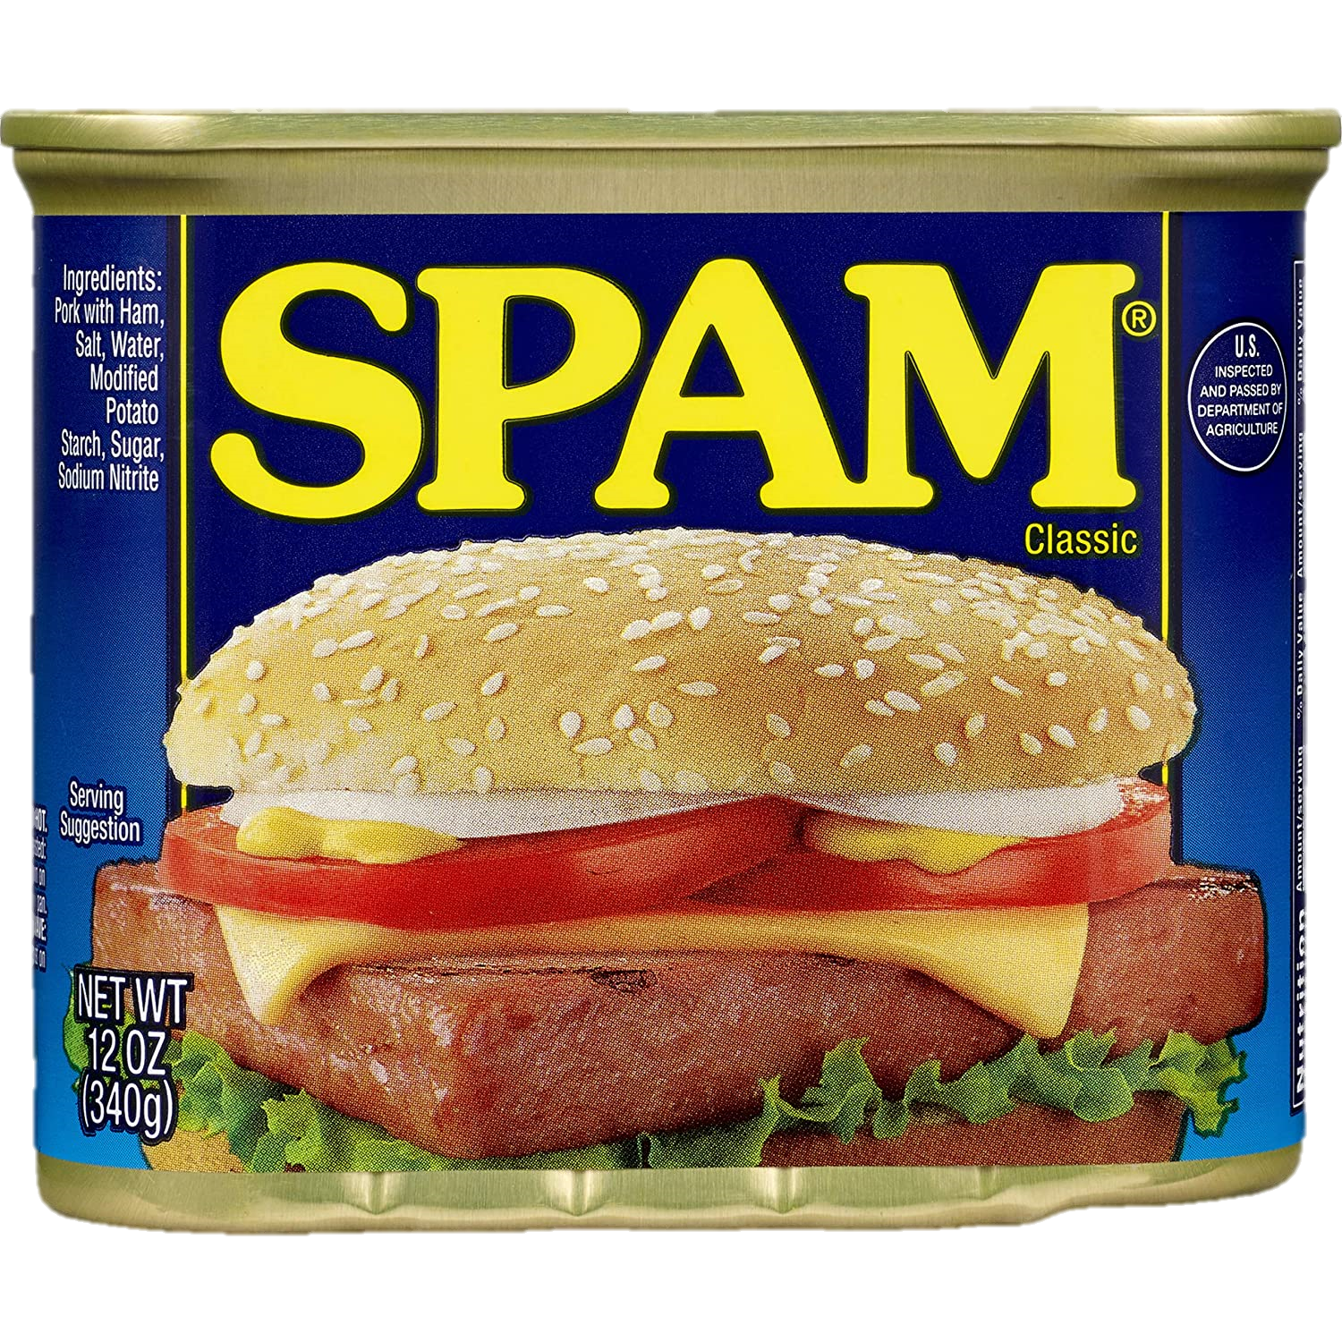



Problem Domain
???????

Slide 5
02
Algorithm

Slide 6
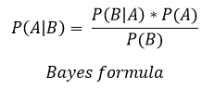
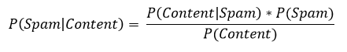
Algorithm

Slide 7
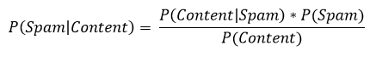
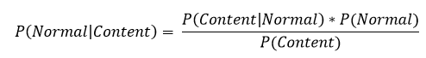
Algorithm (Cont.)
Compute & Compare
&
&

Slide 8
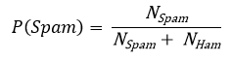
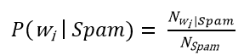
Algorithm Breakdown
For P(Spam):
For P(Content | Spam):
Content = w₁w₂w₃…w_{n}
With

Slide 9
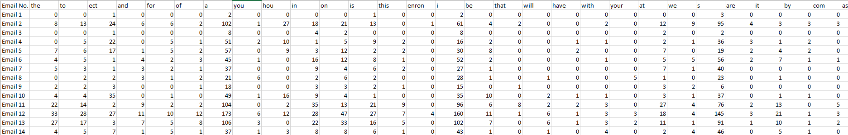
Dataset
https://www.kaggle.com/datasets/balaka18/email-spam-classification-dataset-csv
Ignore all stopwords from the dataset
29%
71%
Spam
Ham

Slide 10
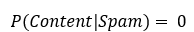
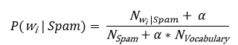
Difficulties
Since we have
If w_{i} never appear in a spam email in the dataset:
Faulty result
Solution:
Basically we count the world from α instead of 0

Slide 11
Difficulties (Cont.)
Number very small
Floating-point underflow
Solution: since if a > b then log(a) > log(b)
we calculate and compare log(P(Spam|Content)) and log(P(Ham|Content)) instead
&

Slide 12
03
Results

Slide 13



Results
Methods: k-fold cross-validation with stratified sampling
Spam |  | Classified by the system |  |  | Normal |  | Classified by the system
 |  | Spam | Normal |  |  |  | Normal | Spam
True class | Spam | 1417 | 83 |  | True class | Normal | 3458 | 214
 | Normal | 214 | 3458 |  |  | Spam | 83 | 1417
$Precision (Spam)= \frac{1417}{1417+ 214}=$86.88 %
$Recall (Spam)= \frac{1417}{1417 + 83}=$94.47 %
$Precision (Normal)= \frac{3458}{3458 + 83}=$97.66 %
$Recall (Normal)= \frac{3458}{3458 + 214}=$94.17 %
$=> Precision \left(Macro\right)= \frac{86.88 + 97.66}{2}=92.27 \%$
$=> Recall \left(Macro\right)= \frac{94.47 + 94.17}{2}=93.32 \%$
$$=>F1= \frac{2∗92.27∗93.32}{92.27+94.32}=92.79 \%$$

Slide 14
04
Conclusion

Slide 15
Conclusion
The AI model achieve a pretty good result although false positive is a problem
Naïve Bayes classification might have a problem of ignore the order of words in an email, which might be crucial to detect if a mail is spam or not

Slide 16
THANK YOU FOR LISTENING!

